Slide 1
November 2024
BIS
Open finance

Slide 2
BIS event description
01
02
03
Small gathering of central bankers
Most of the people were in the regulatory spaces, working for Central Bank
Only a couple of consultancy firms
Organized by the WB
Focus on
Open Finance
Overview of Open Finance and then focus on challenges, operationalization and infrastructure
Discussion around governance framework, fraud, data protection, use cases
Two days
event
7 sessions over two days
Q&A

Slide 3
Definition of Open Finance
Standardized sharing of data and services between financial institutions and other licensed institutions.
Main premises:
Requires consent, for specific purposes by the customer
Consent has a validity period
Data sharing through standardized APIs in a safe, agile, precise and convenient journey

Slide 4
Agenda
Share insights from the event

Slide 5
1
Before starting an open banking initiative, ensure your objectives are clear.
Why are you doing this?
For whom?
With whom?
What are the first use cases?
Notes:
With whom: big techs?/ Open to new members on the same terms and conditions at any time
Georgia’s advice: interact with the non-banking participants to identify and contextualize open banking APIs.
Is it a regulatory or market led approach?
THE WHY IS PARAMOUNT.

Slide 6
2
Pause before you start coding.
Define a clear implementation strategy first.
Then, prioritize API strategy alongside your open banking setup - Will your approach be centralized or decentralized?
Notes:
Set of data is key to get real insights.
Right now the focus is on domestic system though
Turkey:

Slide 7
3
We are just getting started.
In developing countries, only 25% of the population engages with Open Finance.
One-third of countries worldwide are exploring Open Finance implementation, while some still rely on screen scraping.
The opportunity extends beyond financial inclusion—it's about financial health. When done right, Open Finance can become the cornerstone of a financial health strategy.
Notes:
1/3 countries: soma at policy landing stage
Screen scraping: SA
Done right means:
1- break the data siloes
2. Increase competition
3. Spur data innovation
4. Capitalize on what has been done: MSMEs access, gender and access to capital
Done right means monitoring the impact.

Slide 8
4
There’s no one-size-fits-all solution.
However, defining the core components of success is essential.
Governance framework
Fair
Competition
Role of the supervisory and regulatory authorities
Data protection and privacy risk
Incentives
Success!
Infrastructure
Enforcement
Consumer
Awareness
Pricing
Structure
Notes:
No one size fits all: market or reg led – lots of jurisdictions are testing
Governance framework: incentives private public partnership – very different configuration. Various ways of implementing e.g Brazil just working groups, same for SA that are working on implementing an open banking policy. The governance can provide a forum for dialogue with industry.
You need to differentiate between governance, regulatons and policy.
Fair competition: balancing act between innovation and risk + need fair representation of the smaller players
Data protection and privacy risk: public sector is key to establish a safeguard as risk in data exchange. It is all about consent. The success of open banking depends on how you manage the data.
Infra: you need an IPS and you need standardized APIs to avoid wall gardens. Standardized APIs also mean shorter implementation timelines. Some o the outer services can be outsourced
Enforcement: what do you mandate? What is the liability of members? What is the dispute mechanism?
Consumer awareness
Advice: don’t regulate something that you can’t supervise. Do have the tech to monitor the market
Incentives: smaller data holder will find it more difficult. In UAE, they get the banks to be convinced they need to achieve open finance by showing them update and cross-sale
Pricing structure: data share for free vspaid data vs hybrid and when paid who pays the fees? Example: Korea: consent givers pay the fees to information providers. Customers don’t pay any fees. They charge a fee for protection only for premium APOs like making a transfer.

Slide 9
5
The value of Open Finance is undeniable. Key use cases have already been identified, addressing long-standing challenges with proven success.
Lending
Insurance
Personal Finance
Management
Tax payments
Credit Scoring
Wealth
Management
FX
E-KYC
Robo advisor
Business value
Operational efficiency
Notes:
Set of data is key to get real insights.
Right now the focus is on domestic system though.
Benefits: increased innovation and increased access
The potential of open finance is massive: open finance offers consumer optionality and is also an option to look at data differently.
There are market inefficiencies that open finance will close.
PFM: systematic investment
In Georgia, e-KYC was prioritized as face recognition has only 60% success rate.
For SMEs: forecast cash flow and manage cash flow reconciliation, 2) risk calculations (early warnings) and automating accounting processes. Note: SMEs who were turned down a loan do not apply again.
Some numbers and Most popular UC
India: 28% Q-o-Q/10.5b users
India: lending, PFM was the focus
Korea: credit scoring
Brazil: more credit extended and lower interest rate as credit limits are on the data they share. Notification mechanism as well for clients that go overdraft. They can get a credit or do a transfer to avoid overdraft fees.
UAE: deliver the roadmap by 2026. First open banking, then open insurance then open wealth, open FX and open lending.

Slide 10
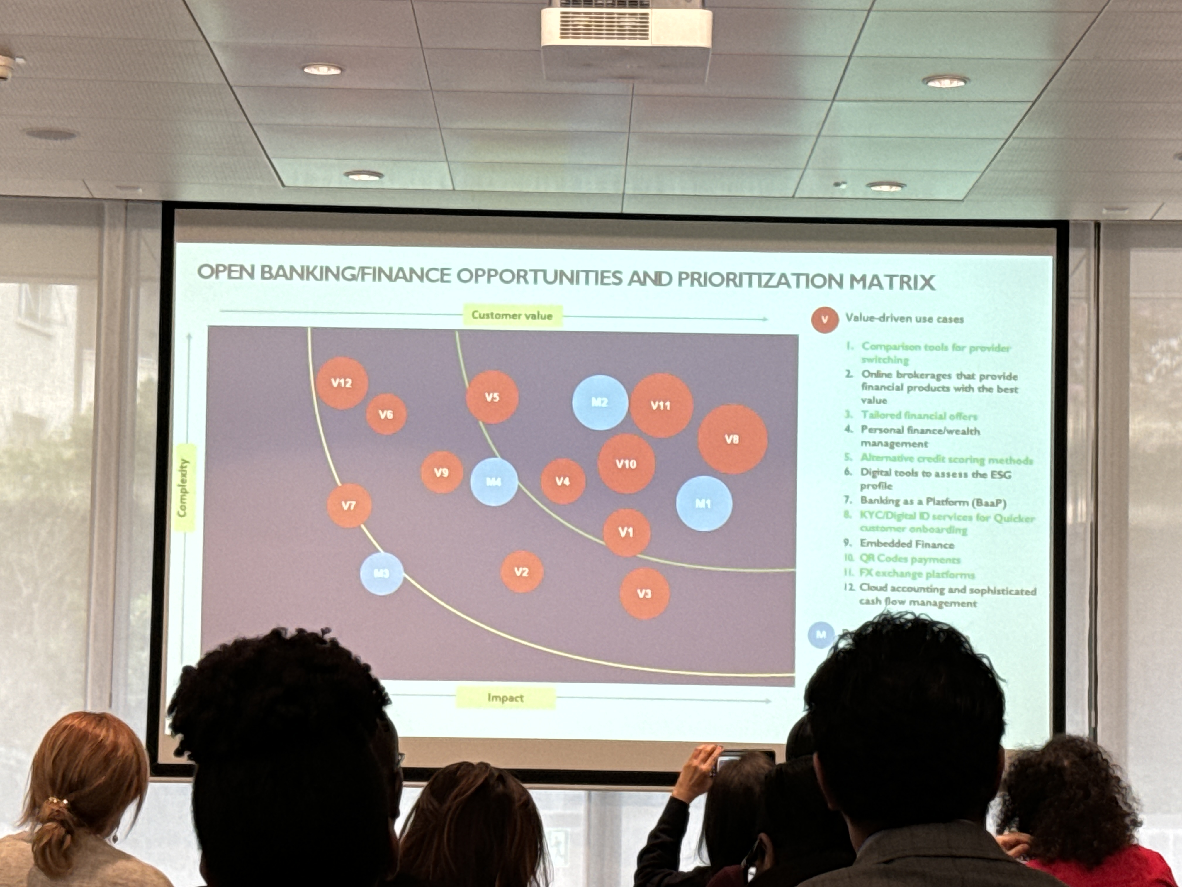
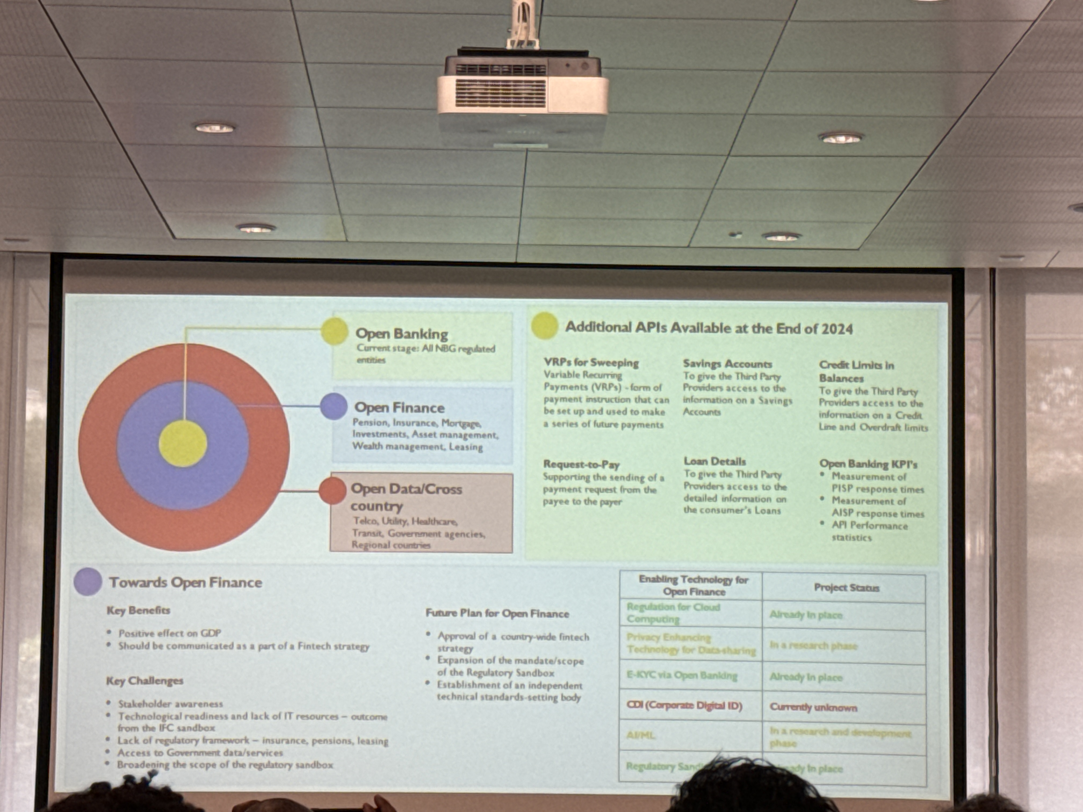
Example of use case analysis - Georgia
Notes:
Geogia: framework used by business strategy.
High demand on Fx so commercial viable
UAE: innovation is the driver, not competition as overbanked in UAE.
unique model with a centralized model. They wanted to make it easier for the banks to connect with fintechs. You connect to the central platform => model is not live yet. They are testing it.

Slide 11
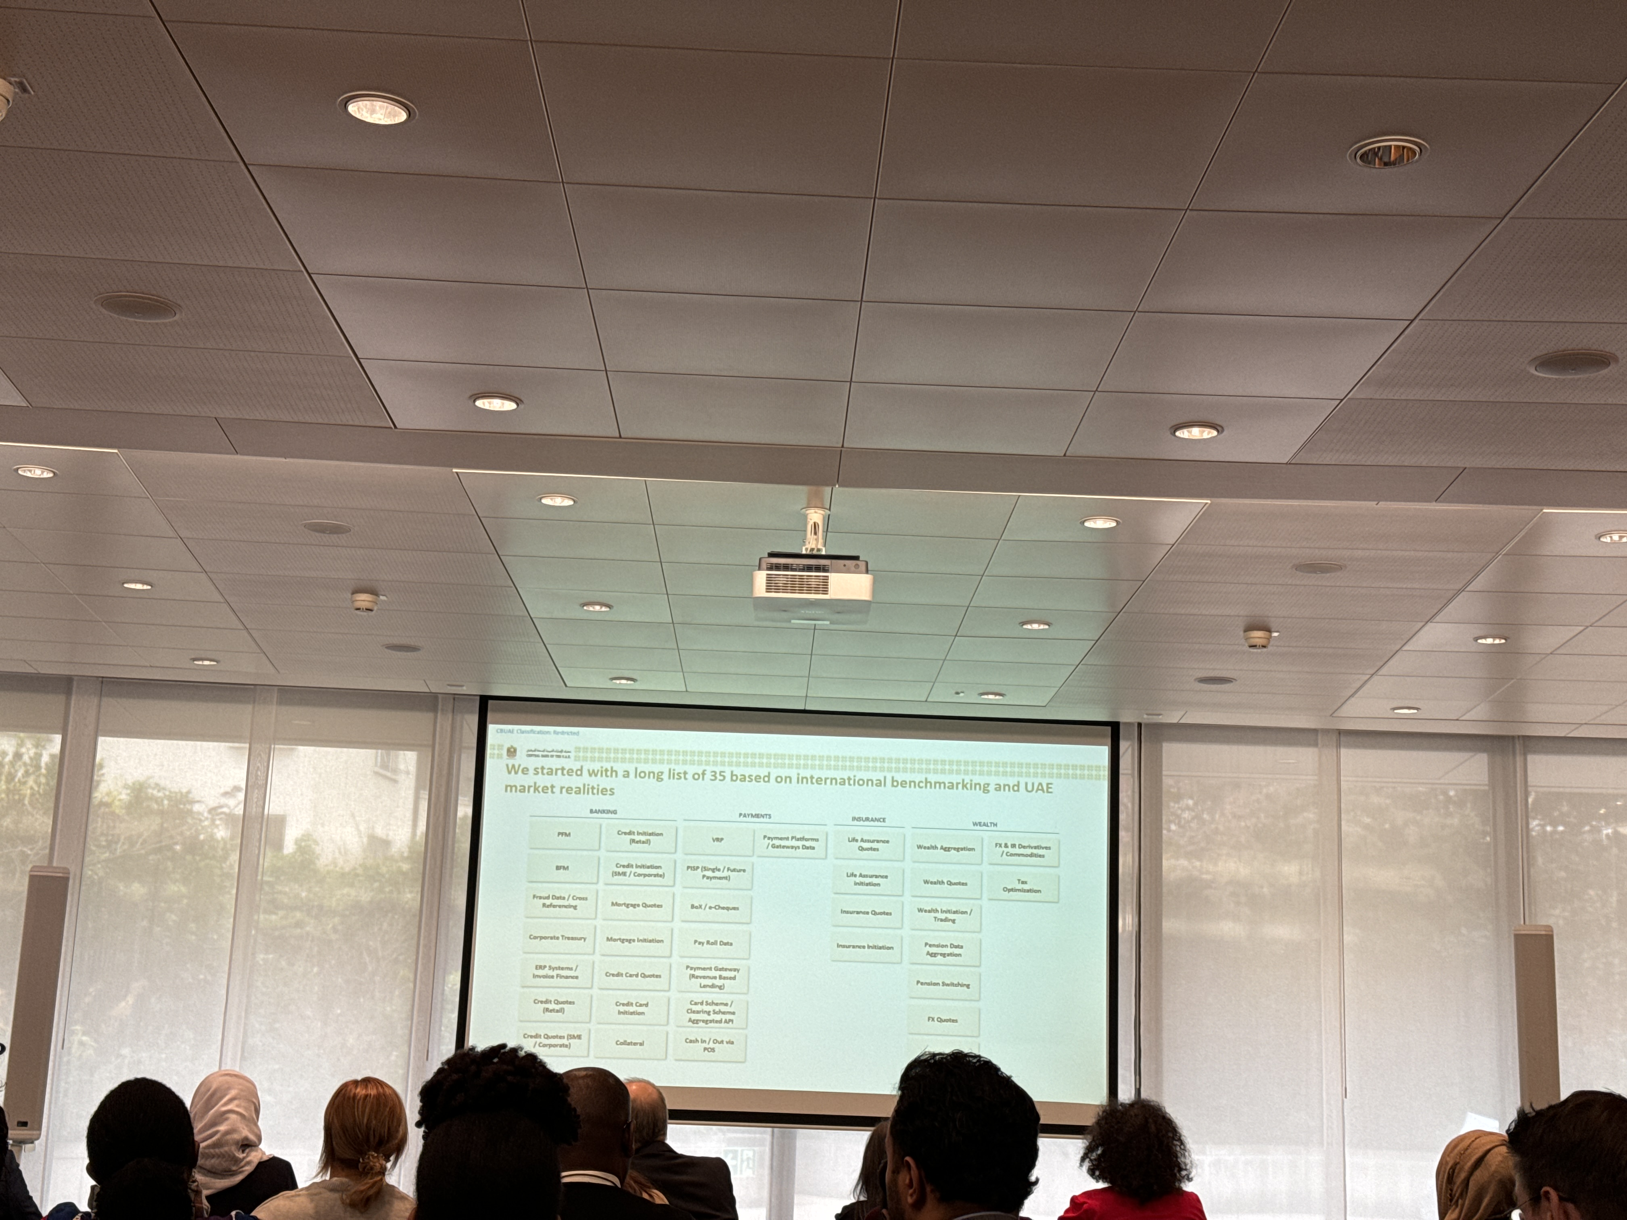
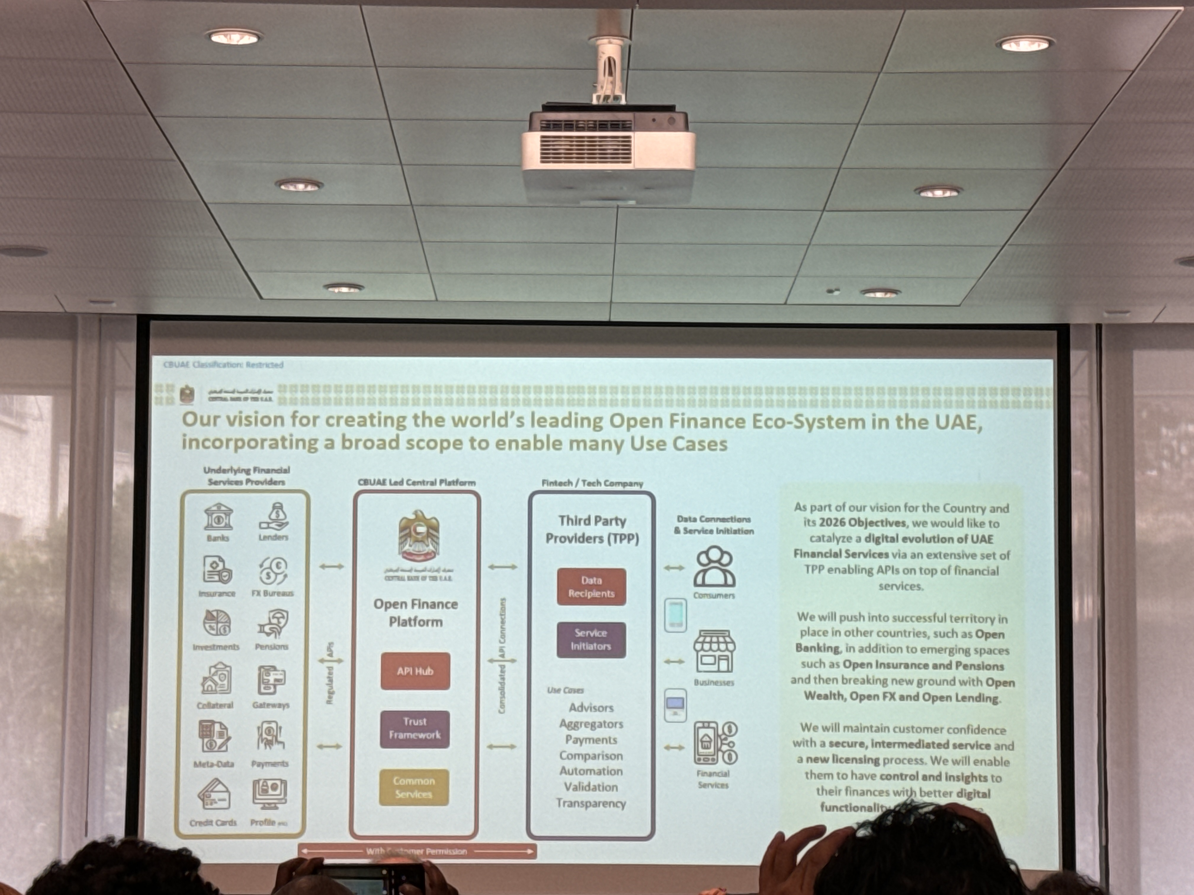
Example of use case analysis - UAE
Notes:
Geogia: framework used by business strategy.
High demand on Fx so commercial viable
UAE: innovation is the driver, not competition as overbanked in UAE.
unique model with a centralized model. They wanted to make it easier for the banks to connect with fintechs. You connect to the central platform => model is not live yet. They are testing it.

Slide 12
6
Industry buy-in is essential, particularly as implementing Open Finance requires significant investment.
This is particularly true in concentrated markets.
Private capital doesn’t flow naturally.
Scalability must be embedded from the very beginning.
Clear understanding of rights is crucial for all stakeholders.
Above all, the customer must remain at the center of every decision.
Notes:
Not cheap as often you need to update your infrastructure and solved your long lasting issues
SA: 95% of the volumes processed by SA
Korea: big banks were reluctant to share their data but FOMO
Georgia shares the experience of high costs. UK has well. The banks had to pay.
All parties need to understand their rights: data sharing guidelines, customer protection, liabilities guidelines
Customer at the center: we need to move from data used to sell something to data to be used to empower the user.
When you mandate, you can do it by wave like Brazil did. Example: before: Mandatory participants to all of the account holding institutions. After: mandatory participants in PIX
Bazril type of actors: account, credit card, credit operations, investment, FX, acquiring, insurance and pension funds
Brazil: 5 institutions represent the majority of the market. Smaller institions wanted to participate to get the data

Slide 13
7
There is a real risk of more exclusion.
Thoughtful design is critical.
Implementing Open Finance must go hand-in-hand with efforts to improve financial literacy.
Hidden risks often go unnoticed due to a lack of supporting data.
Rwanda stands out as a model for South Africa.
In the UK, there is a cost to be poor. It is called the poverty premium!
Notes:
How do you include the digitally excluded? Digital divide could be even worth if open finance is not done properly.
In some countries like Morocco or SA: a lot of payments are still cash usage
Assumption point made by Zambia
Mexico and Columbia: starting with full pop well connected and using open banking but then when you start to segment the population more actually you realise that the penetration is not as good as you thought it was!
Columbia: 35% of Columbians were confident they can identify data theft online. For women, the number dropped to 32%. Low income, 27%, rural Columbian 29%, You need to cater for all the groups!
In the UK: most of the unbanked have been banked before but it was too costly.
.

Slide 14
8
There is no natural home for Open finance.
This is especially true in environments with multiple regulators.
Customer organizations and associations must play a key role in Open Finance development.
Open Finance depends on foundational pillars like internet connectivity and digital identity.
Notes:
Particularly in a multi-regulators environment so coordination is key e.g SA
Often you need to modify the legislation for mobile money operators

Slide 15
9
The path to implementing Open Finance is anything but easy.
Single standard that need to work with a variety or actors.
Enforcement challenges
Customer awareness
Too many cooks
Number of policies
and regulations
Parties awareness and incentives to participate
Notes:
SA: 95% of the volumes processed by SA
Georgia shares the experience of high costs
Number of policies and regulations: PSD2, 2FA, licensing requirements, use of APIs
Brazil’s feedback: requirements are different for data sharing and payment initiation
Uk: FCA, competition market authority, consumer protection and SME protection
Parties awareness. Example: in the UK, fintechs were worried their vulnerabilities will be exposed. Incentives: smaller data holder will find it more difficult. In UAE, they get the banks to be convinced they need to achieve open finance by showing them update and cross-sale
India: You need A LOT patience

Slide 16
10
One bad experience can ruin it all.
Open Banking demands an almost 100% API success rate.
It’s a system play—one high-volume player failing to meet standards or introducing latency could undermine trust in Open Finance permanently.
Availability is critical.
Balancing friction and fraud is a challenge—some friction is necessary, but too much becomes excessive.
Notes:
Set of data is key to get real insights.
Right now the focus is on domestic system though
Turkey:

Slide 17
11
Regulatory sandboxes are your secret weapon.
They help with:
Understanding necessary regulatory changes.
Refining your business model.
Shaping informed regulations.
Offering guidance on critical topics like cyber risk.
The variety of participating actors will evolve over time.
Notes:
Right now the focus is on domestic system though.
Regulatory sandbox roadmap:
1st step: bank
2nd step: non banks like Telco
Chile: in the process of implementing a reg sandbox for

Slide 18
12
Scams must inform your design.
.
Technology can help
Privacy by design is critical.
Policy guidance should be published, with the aim to build consumer trust.
Regulation is required and must include third parties to ensure accountability.
Data holders need to identify, protect, monitor, and intervene.
Technology plays a vital role in supporting these efforts.
Notes:
With more data shared, more risks.
India: digital identity will face massive attack on significant scale. It means the infrasctruture really need to be secured.
Privacy by design is key
Publish policy: example: guidelines on how to supervise and include data protection issue among market conduct protection scheme
Eaxmple of regulations: financial institutions must carry due diligence when linking data. Specific information disclosure based on consent. Over the board they are looking at pushing the liabilities on the provider.
Great tech in this space: consent dashboard, smart contract on treaceability of data
Tyme: they ask consent on the data they use. Example: when a customer applies for a loan, they ask data. Use of metadata like number of phone calls or pictures but only with consent. If data has not brough any value, then consent is revoked.
Consumer awareness is key. Example: in India, TV commercial. BUT sometimes too much info. They also coordinated consumer campaign in rural areas.
India: collaboration with center of crime.

Slide 19
13
The next step is to have interoperable pool of data.
Project Aperta and Project Aurora are exploring this vision.
Georgia aims to position itself as a hub for the Middle Corridor.
Extra-territorial parties will seek access to shared data.
Mutual recognition of licenses will be crucial for collaboration.
Notes:
Set of data is key to get real insights.
Right now the focus is on domestic system though
Challenges: 1) lack of international API and data portability standards (highly fragmented landscape), lack of implementation and impetus (standardization exists in trade finance digitized forms but hasn’t been implemented, lack of internationally recognized data standards (preventive barrier for SMEs and consumers who exist and work across border), lack of global API aggregation/interoperability
Project Aperta will seek to enable cross-border data exchange and payment initiation through connecting Domestic Open Finance ecosystems. UK, UAE, HK, Georgia are part of this along with GLEIF. The project aims to reduce frictions by enabling seamless cross-border data portability. Purposes create harmonization of protocols. Bunch of APIs that will be linked. Use cases: faster bank account opening, trading with digitalization of trade standards, smooth and frictionless experience: suppliers can receive funds from different jurisdictions.
Attractive for jurisdictions that haven’t started yet as they could learn from Aperta/
Chile is such a small countries that other parties want to access the data/
Brazil: not even in-country interoperability: right now open finance only on the payments initiated by PIX.
Georgia: mutual recognition of license. They want to be a middle corridor. Market to small vs investment

Slide 20
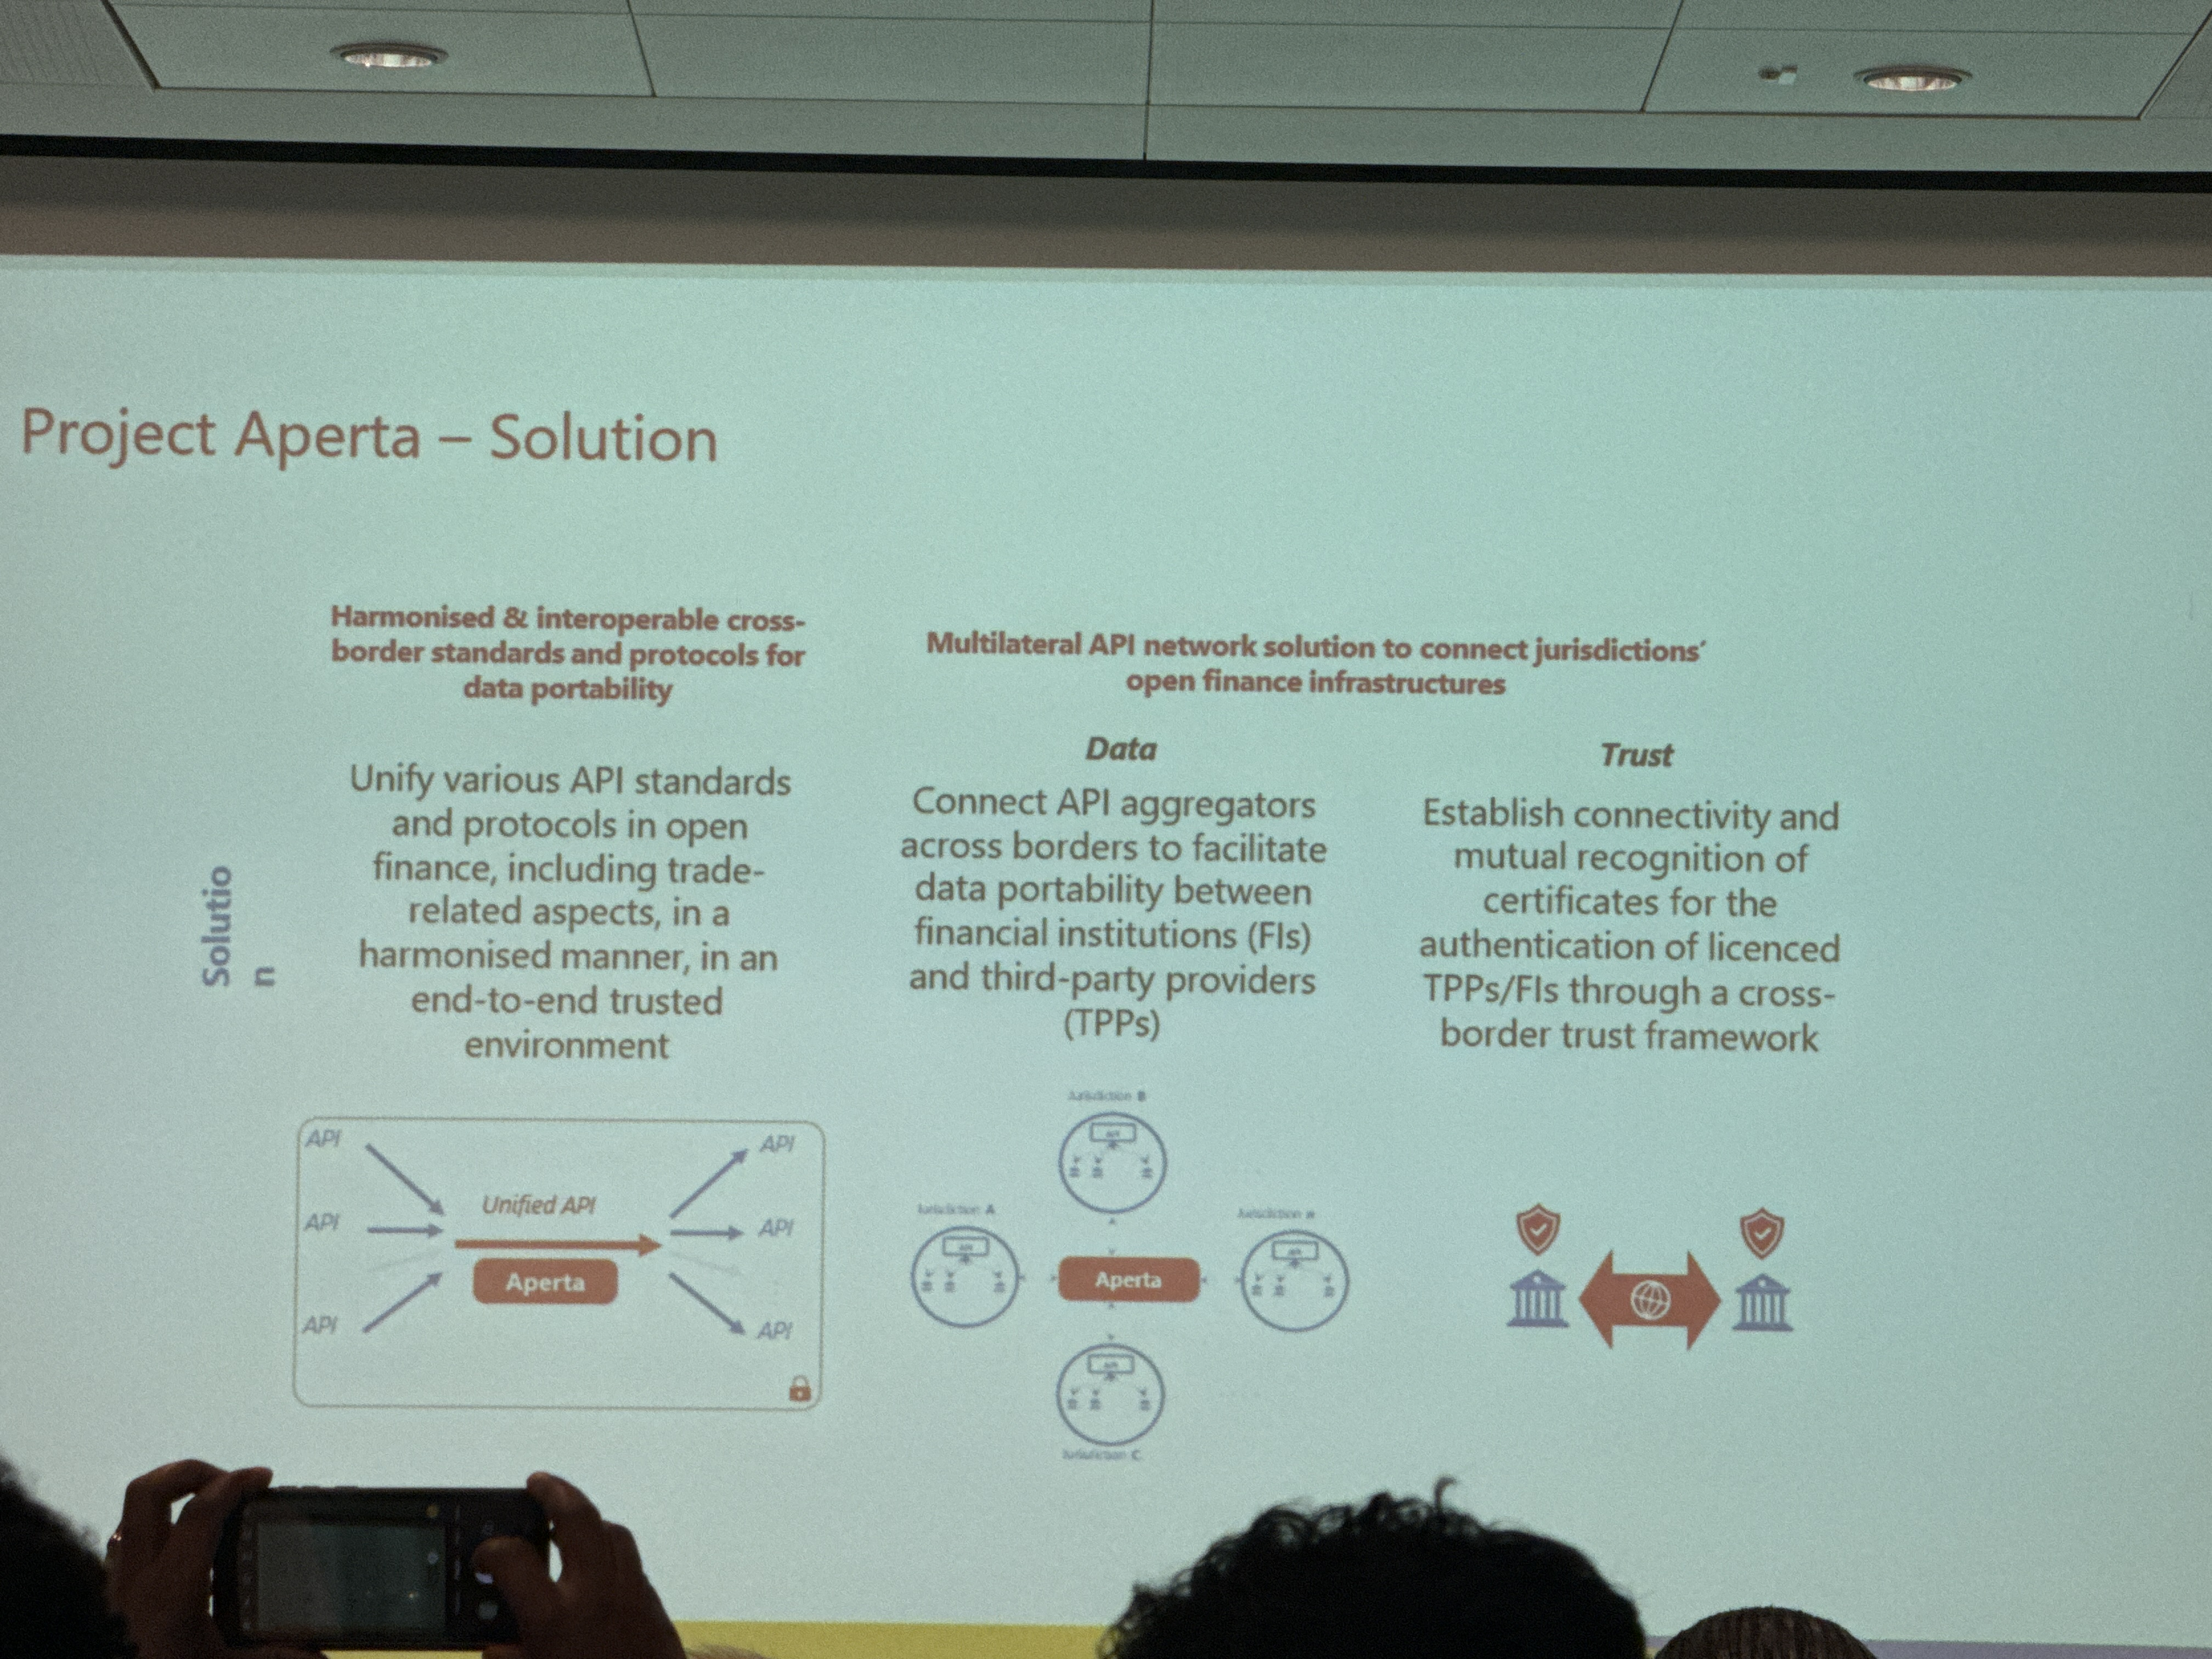
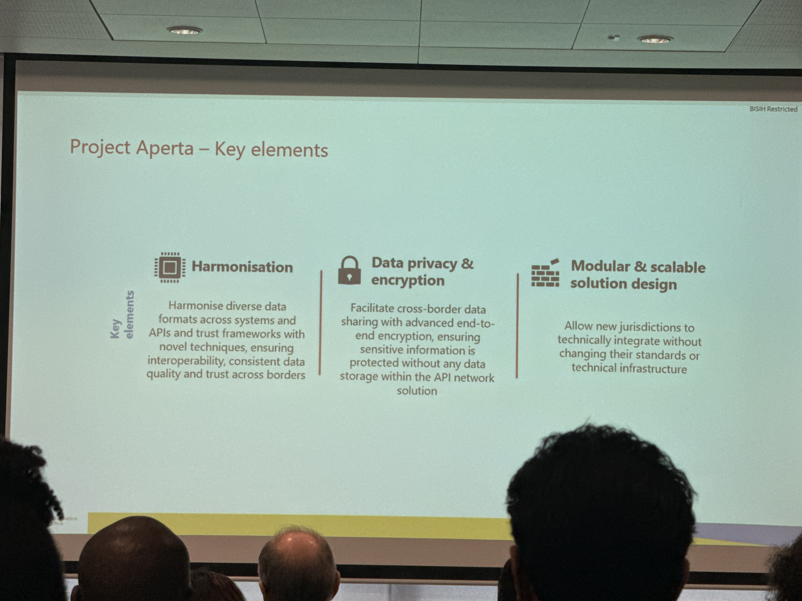
Project Aperta overview

Slide 21
Thank You!

